Slide 1
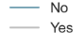
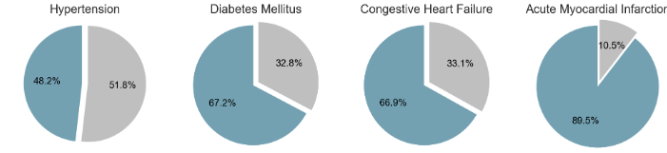
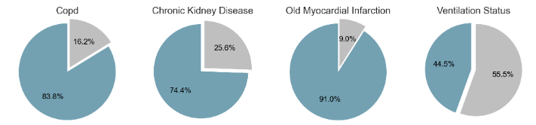
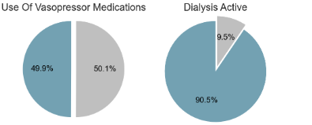
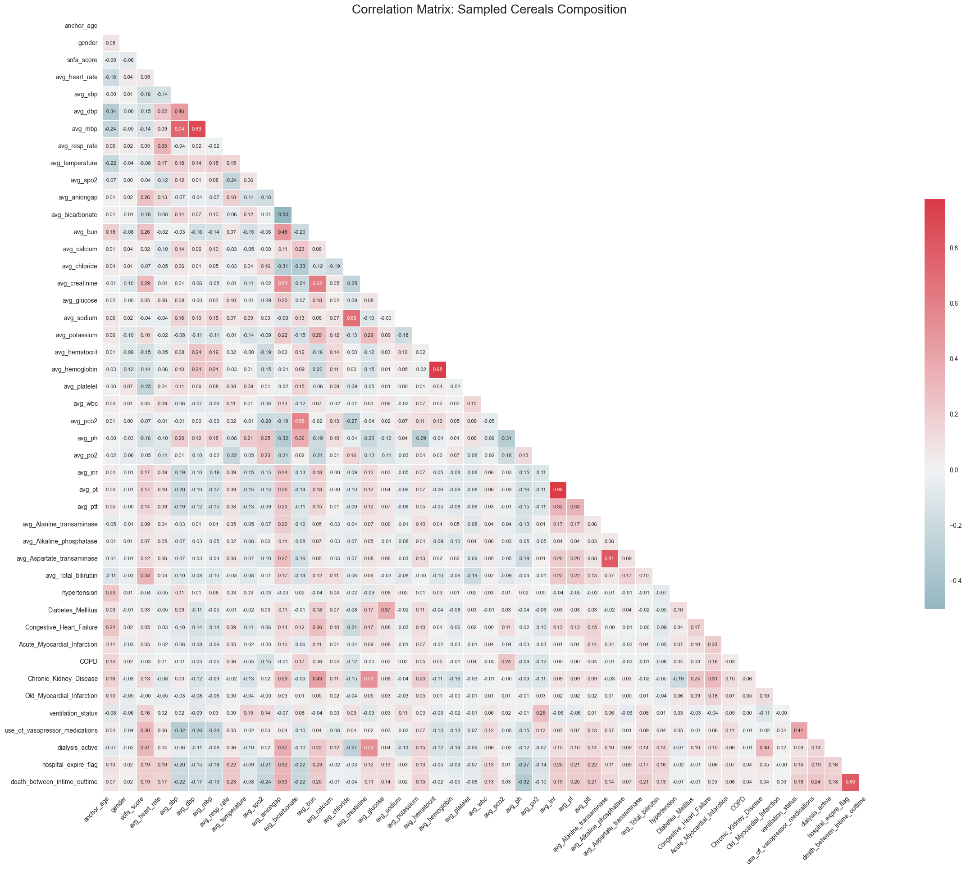
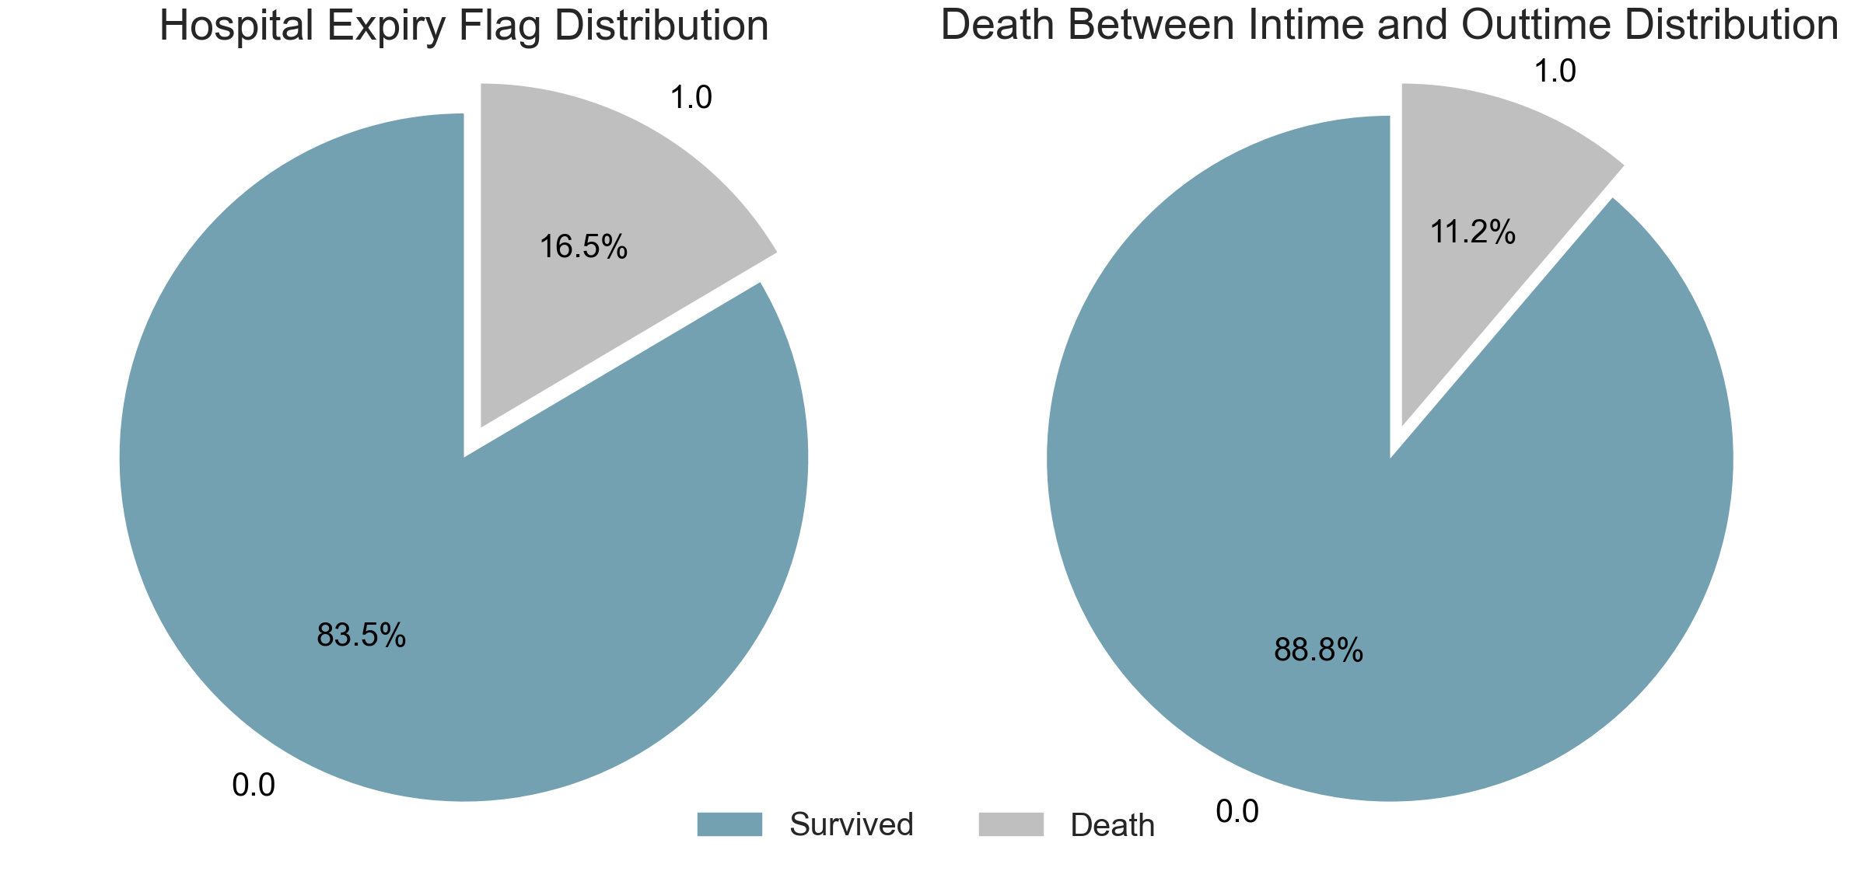
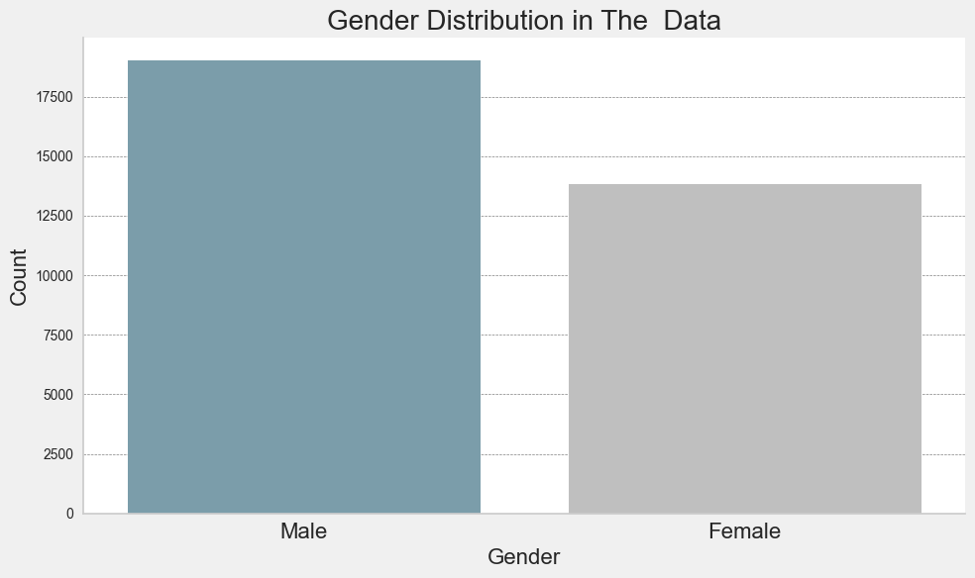
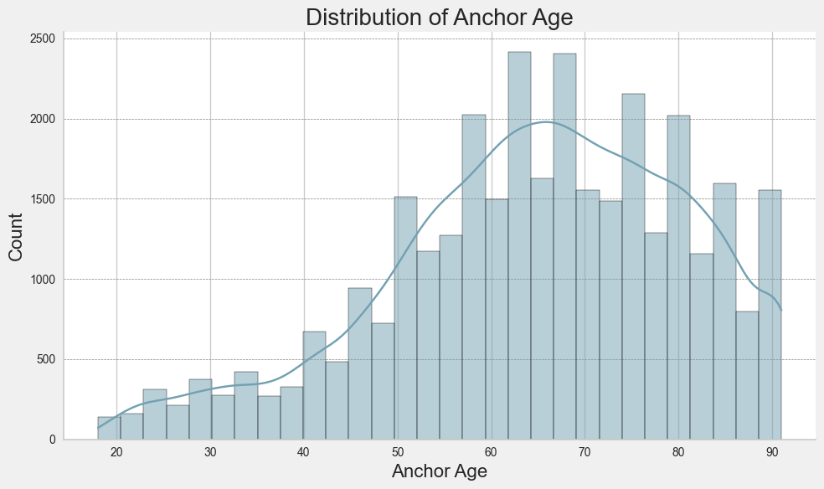
Visual Data Analysis of Hospitalized Patients
Survived | Deceased: | Total Patients | Feature
27420 | 5414 | 32848 | Hospital Expire Flag:
29149 | 3685 | 32848 | Death Between Intime and Out- time:

Slide 2
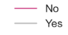
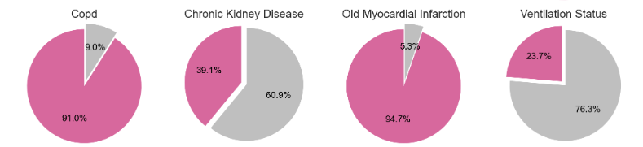
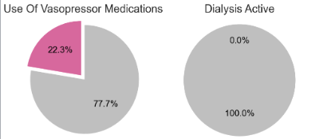
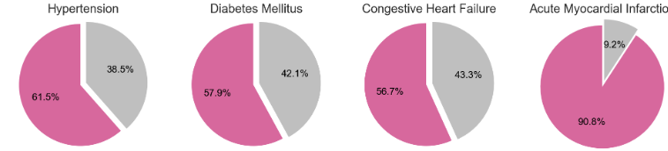
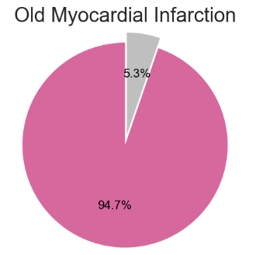
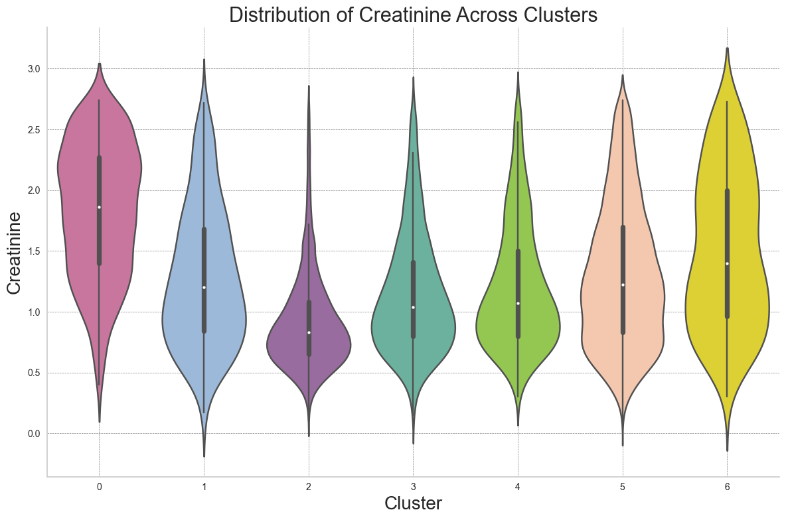
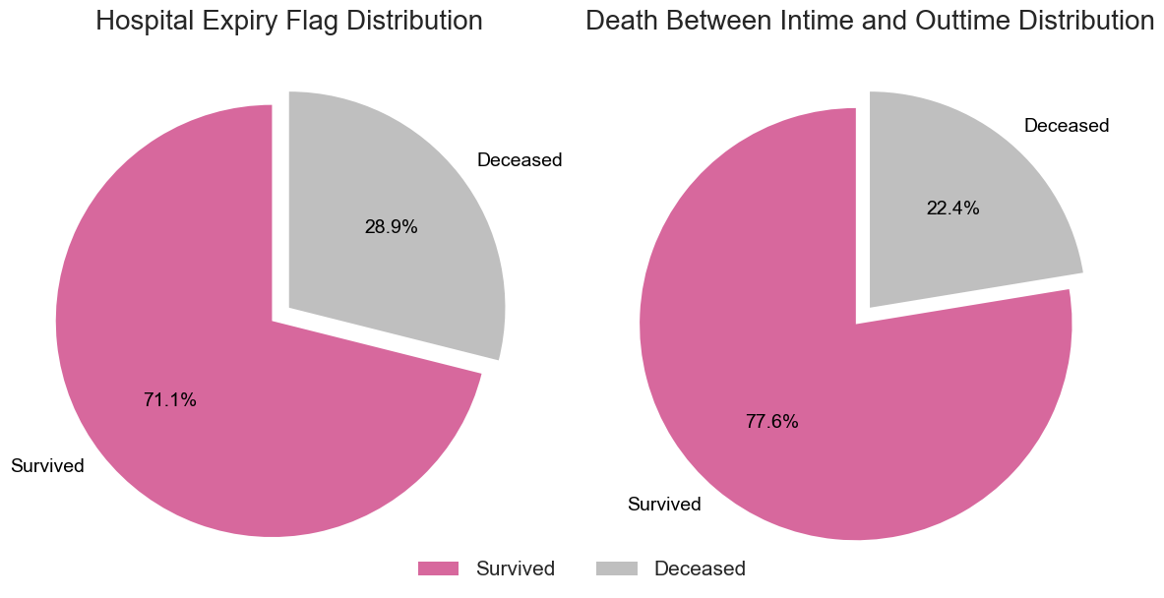
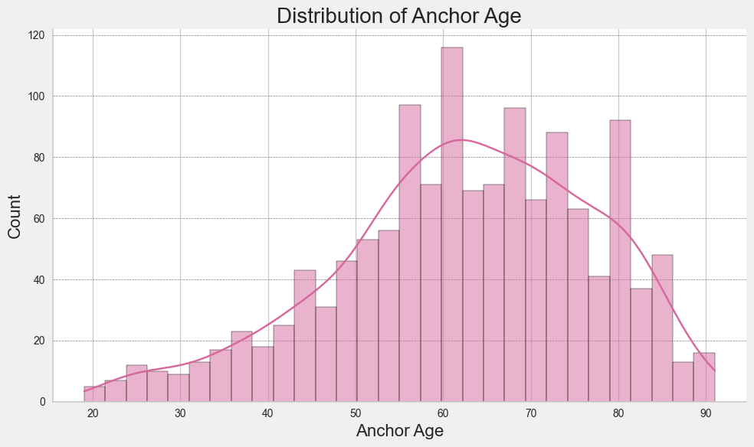
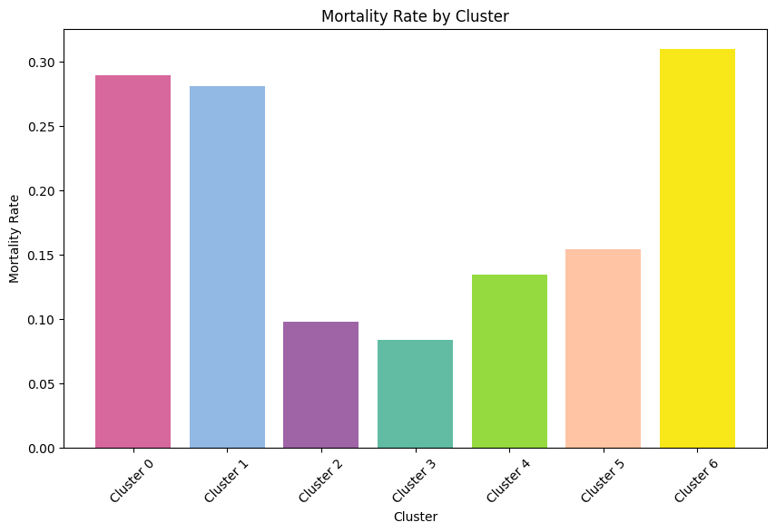
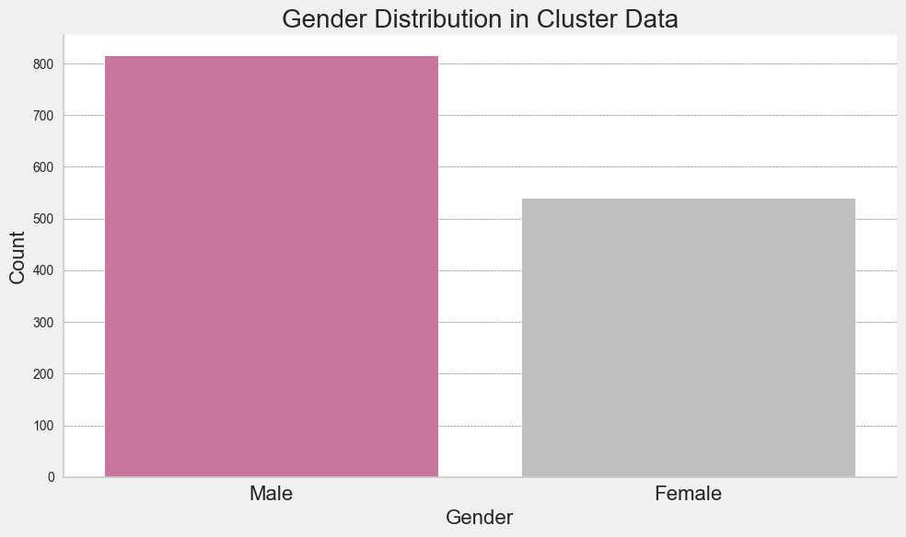
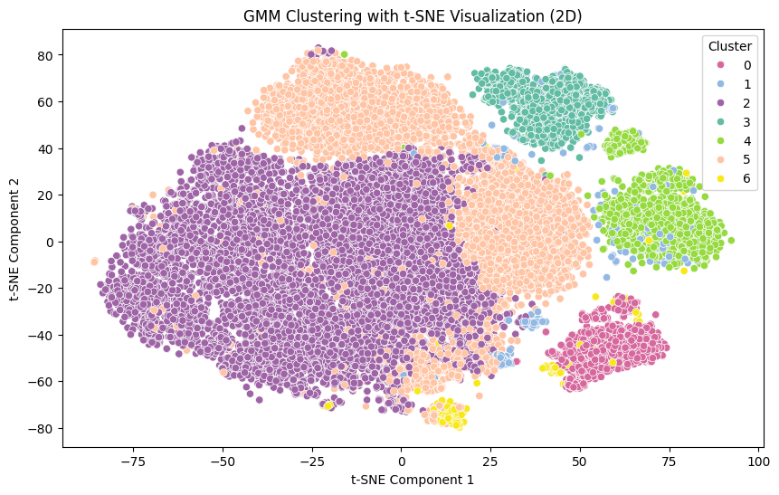
Detailed Insights from Training Data on Cluster 0: Patient Demographics and Health Outcomes
Mortality Rate | Total | Deceased | Survived
0.289201 | 1352 | 391 | 961

Slide 3

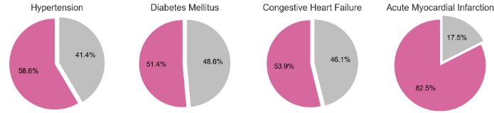
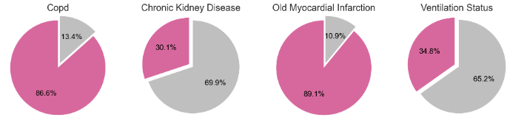
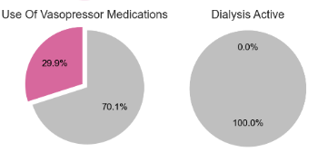
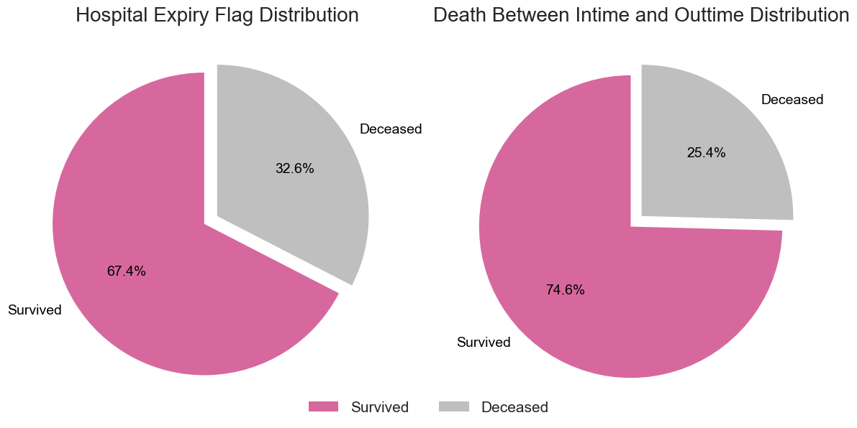
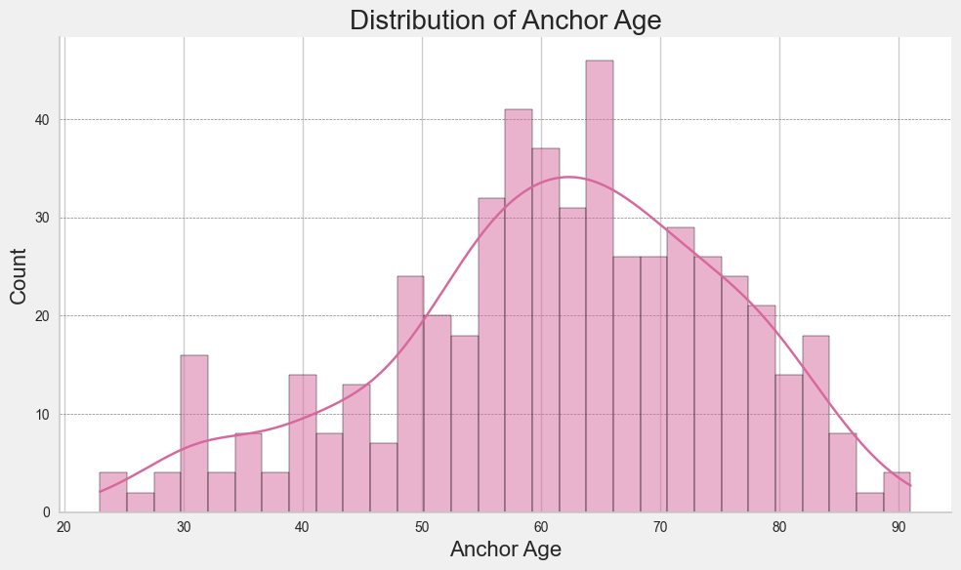
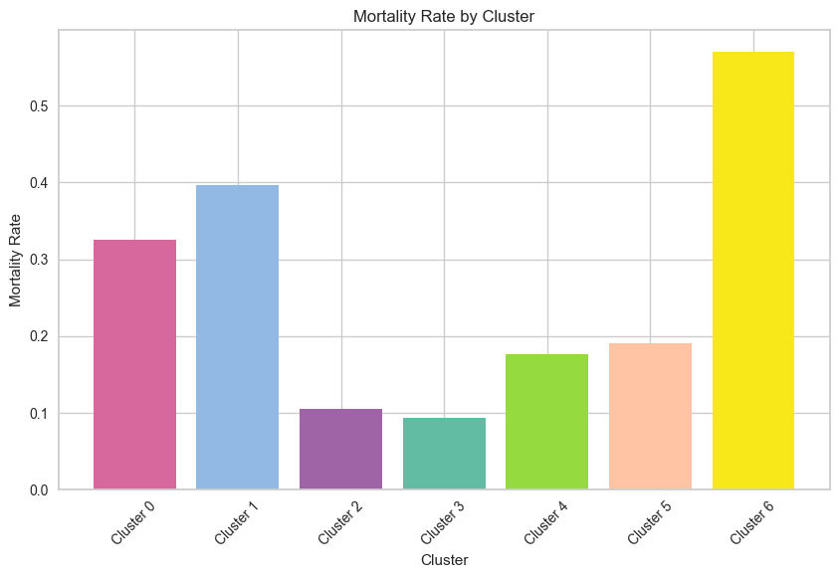
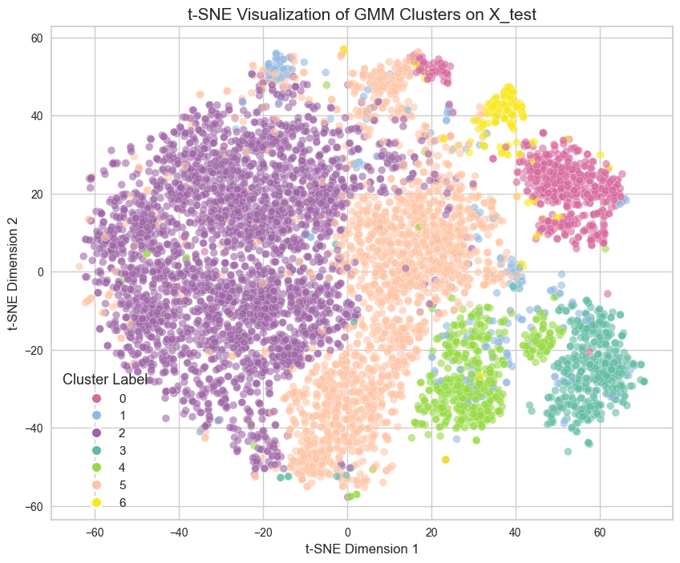
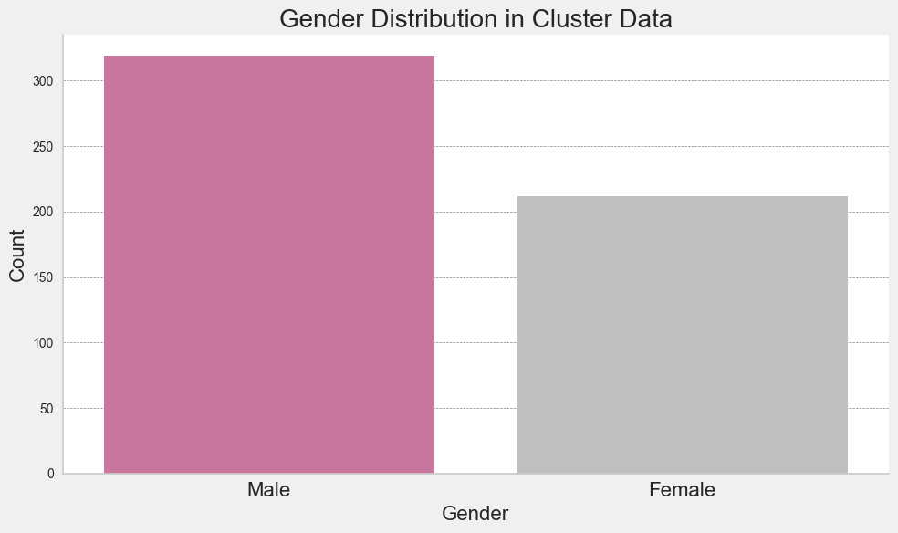
Detailed Insights from Test Data on Cluster 0: Patient Demographics and Health Outcomes
Mortality Rate | Total | Deceased | Survived
0.325800 | 531 | 173 | 358

Slide 4
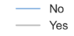
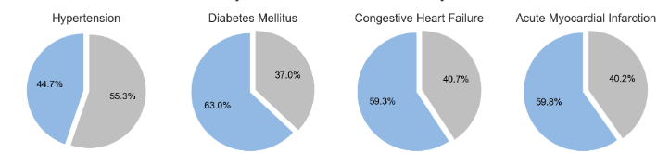
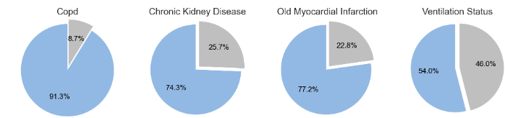
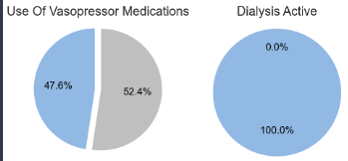
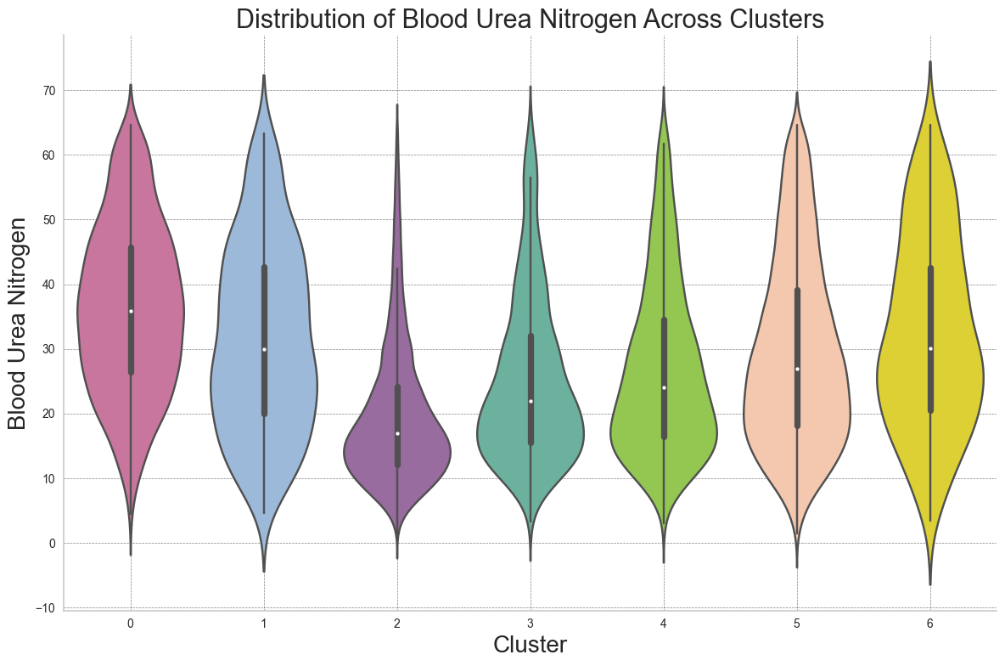
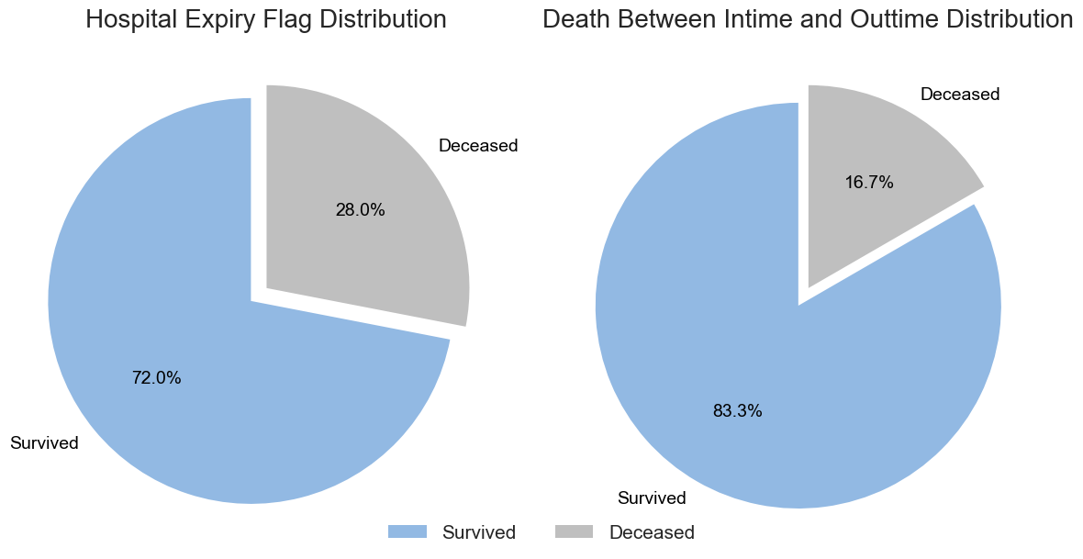
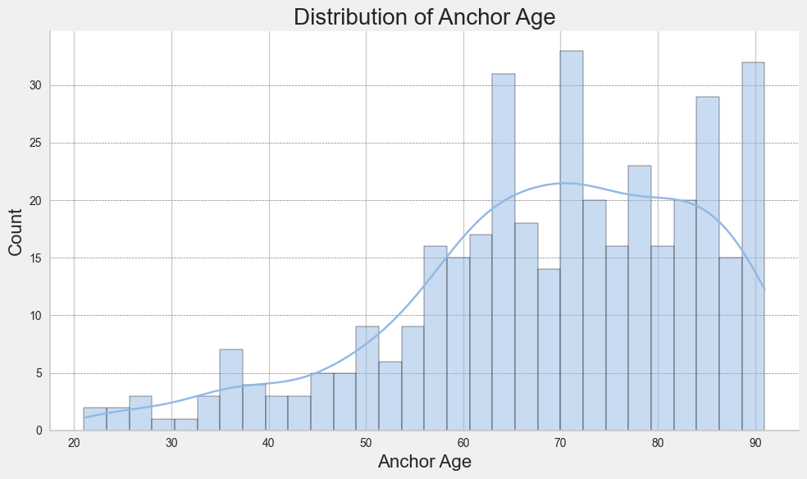
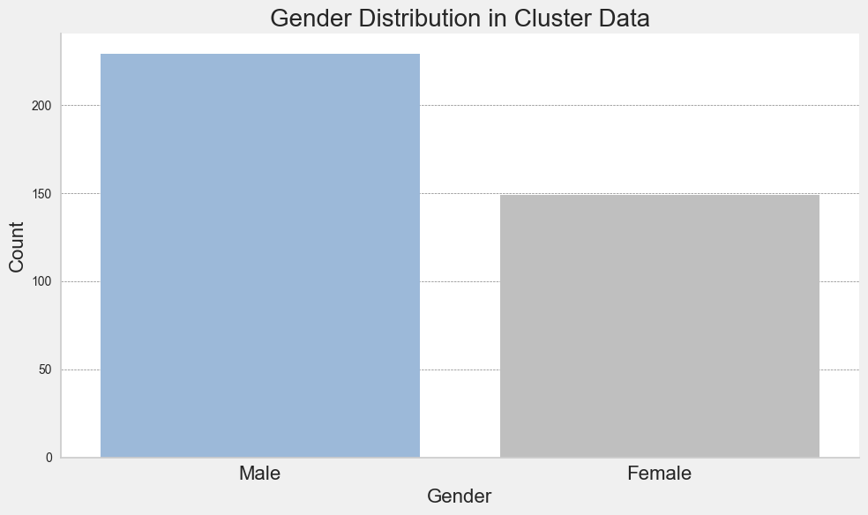
Detailed Insights from Training Data on Cluster 1: Patient Demographics and Health Outcomes
Mortality Rate | Total | Deceased | Survived
0.280423 | 378 | 106 | 272

Slide 5
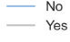
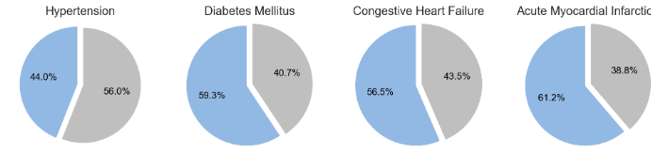
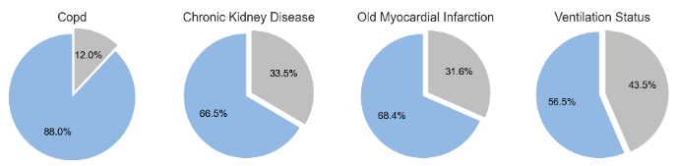
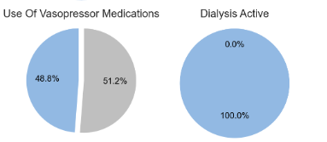
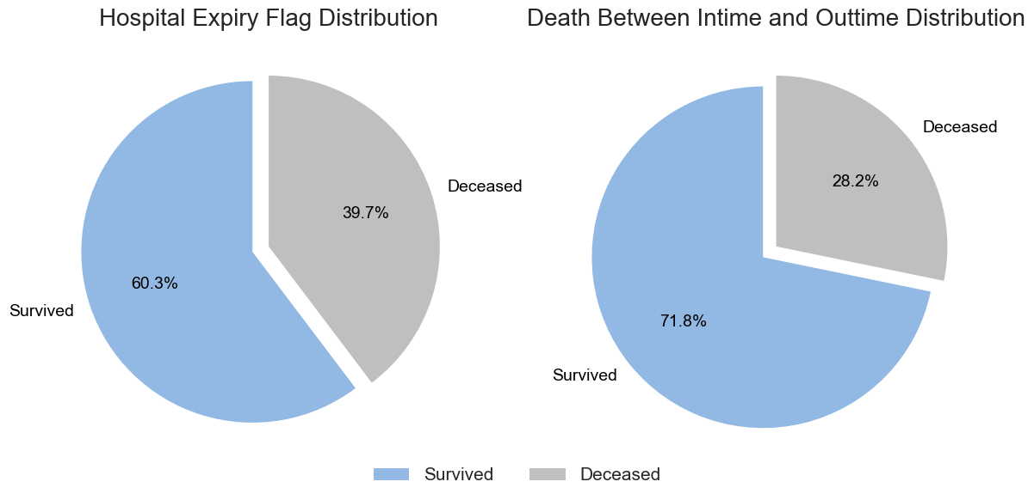
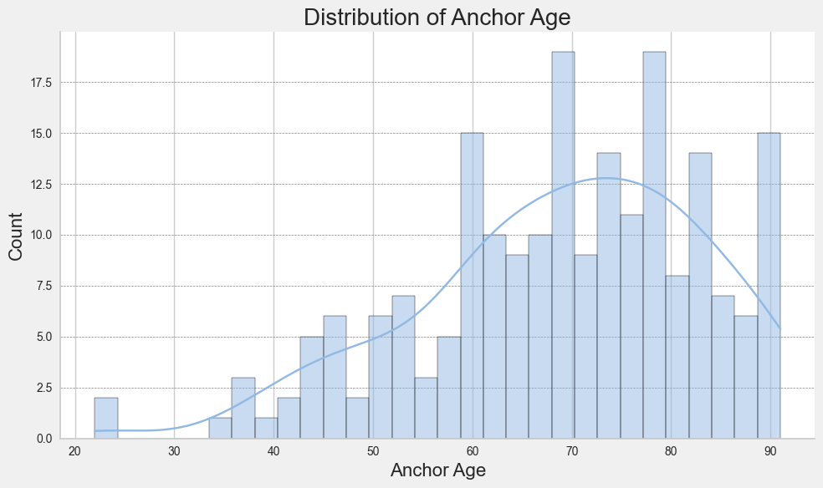
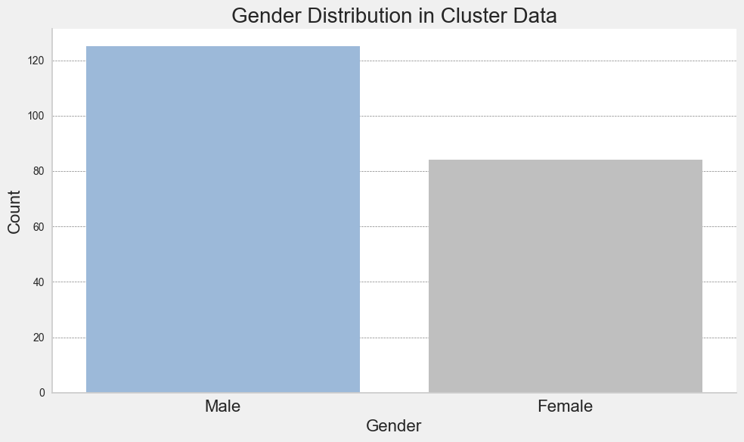
Detailed Insights from Test Data on Cluster 1: Patient Demographics and Health Outcomes
Mortality Rate | Total | Deceased | Survived
0.397129 | 209 | 83 | 126

Slide 6
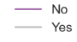
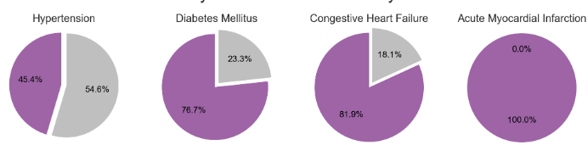
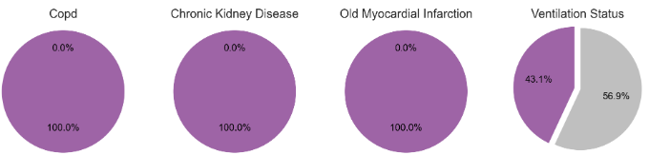
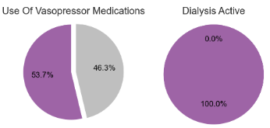
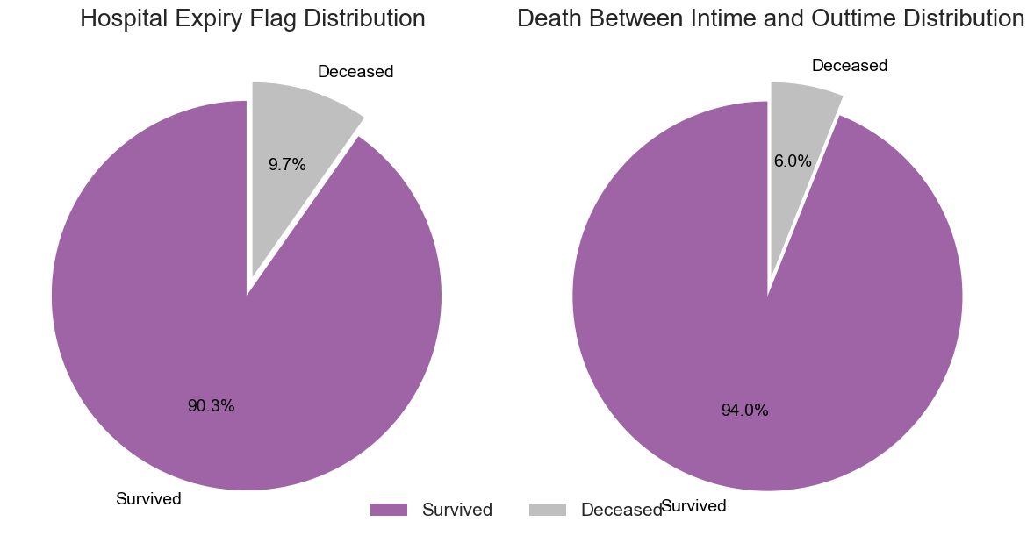
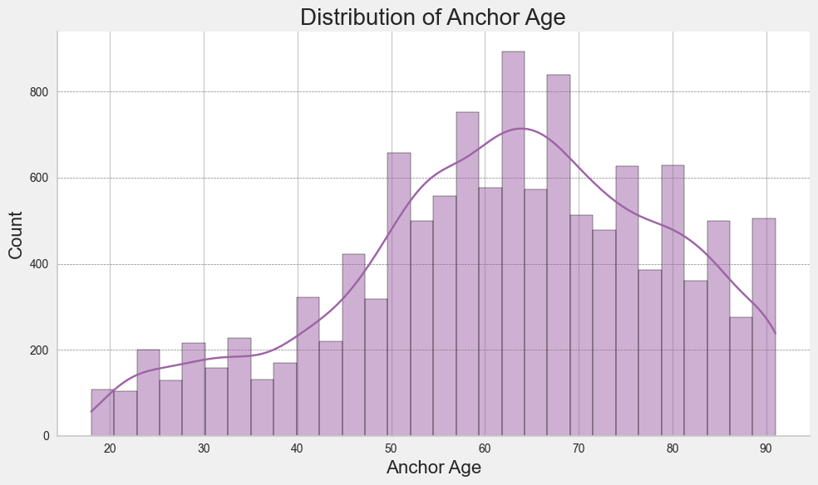
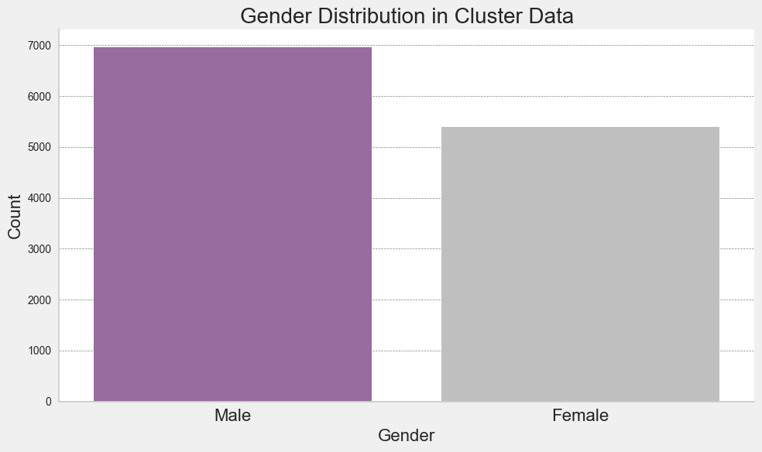
Detailed Insights from Training Data on Cluster 2: Patient Demographics and Health Outcomes
Mortality Rate | Total | Deceased | Survived
0.097352 | 12347 | 1202 | 11145

Slide 7

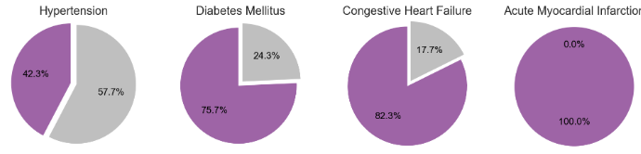





Detailed Insights from Test Data on Cluster 2: Patient Demographics and Health Outcomes
Mortality Rate | Total | Deceased | Survived
0.105437 | 3035 | 320 | 2715

Slide 8








Detailed Insights from Training Data on Cluster 3: Patient Demographics and Health Outcomes
Mortality Rate | Total | Deceased | Survived
0.083791 | 1456 | 122 | 1334

Slide 9








Detailed Insights from Test Data on Cluster 3: Patient Demographics and Health Outcomes
Mortality Rate | Total | Deceased | Survived
0.093822 | 437 | 41 | 396

Slide 10








Detailed Insights from Training Data on Cluster 4: Patient Demographics and Health Outcomes
Mortality Rate | Total | Deceased | Survived
0.134221 | 1803 | 242 | 1561

Slide 11








Detailed Insights from Test Data on Cluster 4: Patient Demographics and Health Outcomes
Mortality Rate | Total | Deceased | Survived
0.176871 | 441 | 78 | 363

Slide 12








Detailed Insights from Training Data on Cluster 5: Patient Demographics and Health Outcomes
Mortality Rate | Total | Deceased | Survived
0.153921 | 6146 | 946 | 5200

Slide 13








Detailed Insights from Test Data on Cluster 5: Patient Demographics and Health Outcomes
Mortality Rate | Total | Deceased | Survived
0.190531 | 1753 | 334 | 1419

Slide 14










Detailed Insights from Training Data on Cluster 6: Patient Demographics and Health Outcomes
Mortality Rate | Total | Deceased | Survived
0.309804 | 255 | 79 | 176

Slide 15








Detailed Insights from Test Data on Cluster 6: Patient Demographics and Health Outcomes
Mortality Rate | Total | Deceased | Survived
0.569536 | 151 | 86 | 65

Slide 16






Predicting Mortality in Intensive Care Units Using CatBoost Classifier

